Slide 1

Slide 1
Bank Loan Of Customers
(Finance)

Slide 2

Our team (group:2)
Miss. Ayushi Ketan Ichchhaporia
MR. Ganesh Anil Chavan
Mrs. Komal Pradeep Deshmukh
Mr . Rohit Pradip Sapkale
Mrs. Juwairiya Khan
Ms. Harshitha Natrayan

Slide 3

Project objective
The objective of this project is to conduct a detailed analysis of bank loans provided to customers over multiple years. Through this analysis, We aim to gain insights into the trends, patterns, and changes in loan behavior, customer preferences, and risk profiles over time. The primary focus is on understanding the dynamics of loan disbursement, repayment patterns, default rates and overall performance of loan portfolios across different years.
Subsequently, the data undergoes rigorous cleaning, filtering and preprocessing procedures to ensure accuracy, consistency, and suitability for analysis. Finally, informative and visually appealing dashboards, charts and reports are generated to present key findings, insights and recommendations derived from analysis, facilitating informed decision- making and strategic planning.

Slide 4

IMPLEMENTATION OF KPI’S
Year wise loan
Grade & Sub Grade wise Revol_balance
Total Payment for verified vs
Non verified
Home ownership vs last Payment Date
State and
Last credit Pull Date
State

Slide 5
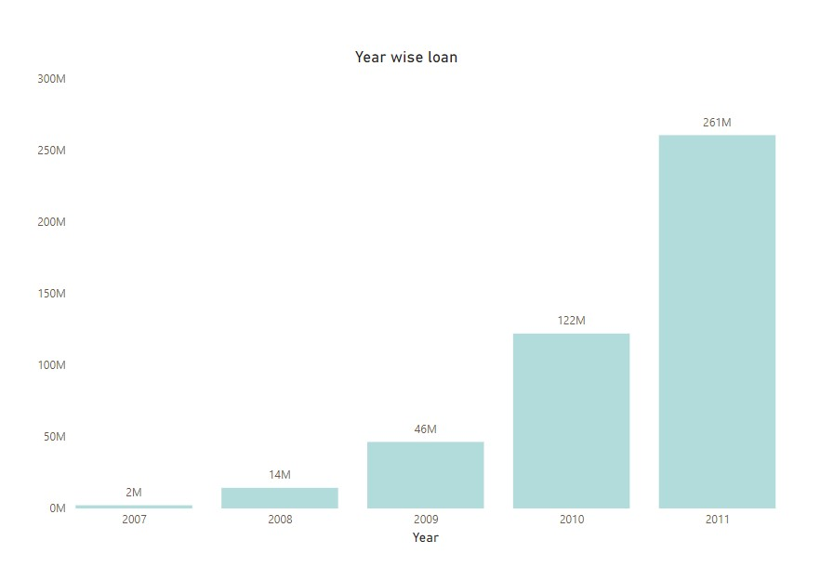
Kpi :1
Year Wise Loan
The graph clearly indicates an upward trend in loan amounts over the years. The total loans distributed have consistently risen from 2007 to 2011. The most remarkable increase occurred in 2011, where the total loans reached an impressive ₹261 million. This substantial surge suggests a notable change in lending patterns during that year.
Create loan products that align with borrower needs during peak years.
Financial institutions need to assess the risk associated with higher loan volumes. Managing credit risk becomes crucial as loan amounts escalate.

Slide 6

Slide 6
KPI : 2
The line graph indicates the sum of Revol Balance across various credit grades reveals insightful trends. Grade B stands out with the highest Revol Balance, indicating the strength of borrowers in this category. Conversely, there's a consistent decline in Revol Balance as we move to lower grades (C to G).
To understand the underlying reasons for the trends we can explore factors like utilization, payment history and credit mix.
kpi

Slide 7
KPI : 3
The larger green segment represents the verified status.
The total payment for verified accounts is ₹21,98,92,308.
The smaller red segment represents the non-verified status.
The total payment for non-verified accounts is ₹15,35,34,113.
Financial institutions can use this data to assess risk. Verified accounts may be considered lower risk due to the higher payment amounts.
Tailoring strategies based on verification status can optimize payment collection. For instance, follow-ups or incentives could be offered to non-verified accounts.

Slide 8
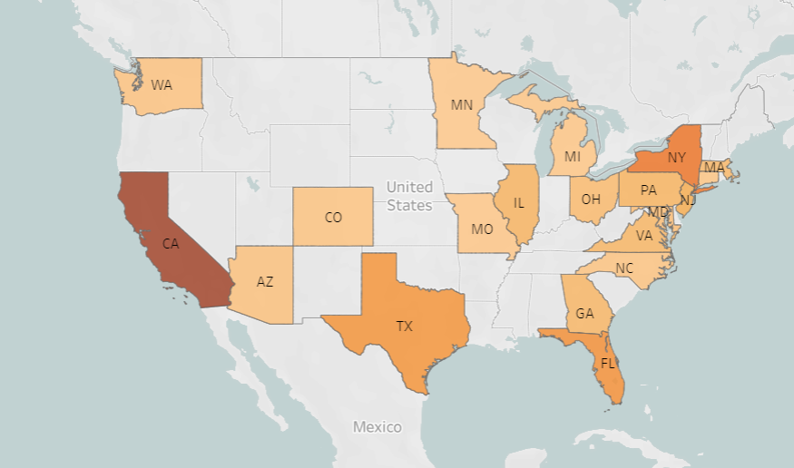
KPI : 4
State wise & last credit pull wise Loan Status
The map shows the count of Loan status in top 20 states of America on particular last credit pull date.
As we can see California has the most number of customers who took loan i.e 7099 (count of loan status).
Next is, Texas, Florida and New York. These are the states that has more amount of loans as compared to other states.

Slide 9

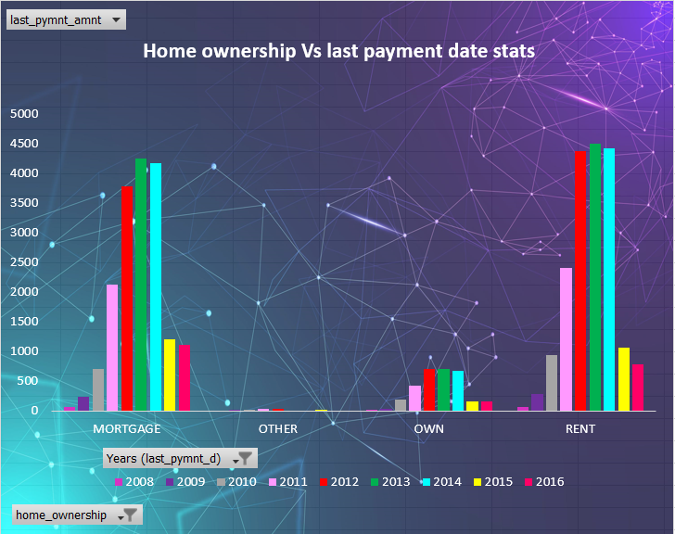
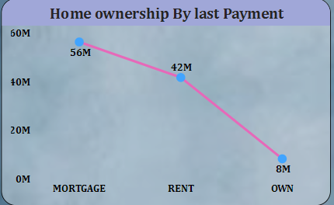
KPI : 5
Home ownership and last payment date stat
The given charts shows home ownership and the amount paid for each on last payment date.
As we can see, the maximum latest amount is paid by Mortgage customers with 56M.
.

Slide 10
Kpi 5:Sub chart
42M
8 M
56M
Renters
Ownership
Mortgage
Around 42 million individuals have rent as their last payment type. These are likely people who do not own their homes and are renting instead.
only about 8 million people own their homes outright. This means they have fully paid off their mortgages or purchased their homes without financing.
The majority of people (56 million) have a mortgage as their last payment type. This suggests that a significant portion of homeowners are still paying off their homes through mortgage loans.

Slide 11
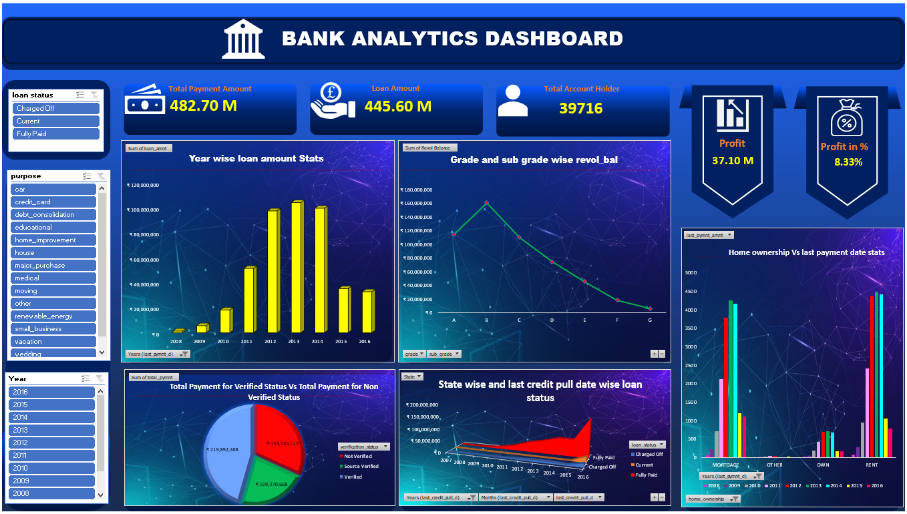
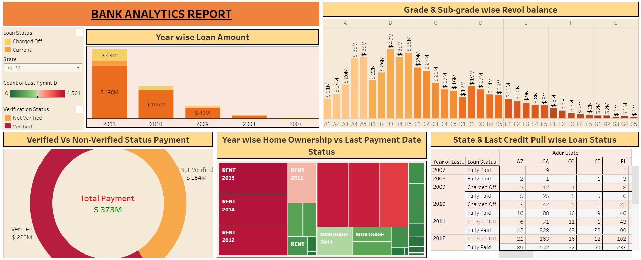
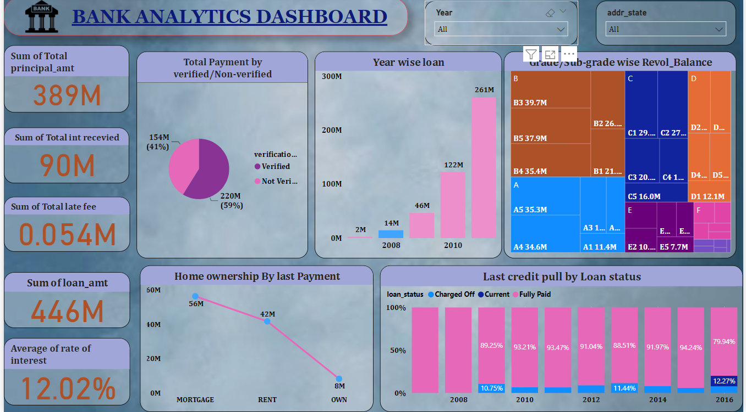
Dashboards Created for this project
Upcoming Deposits
$704.78
$191.01
Upcoming Deposits
35.41% from last week
29.47% from 6 months ago
$189.31
$186.54

Slide 12

Slide 10
Conclusion
There is a noticeable upward trend in loan amounts over consecutive years, indicating a growing customer base. The loan status distribution reveals that "Fully Paid" holds the highest count at 32,950, followed by "Charged Off" at 5,627, and "Current" at 1,140.
Analysis of revolving balances shows that customers with a grade 'B' rating have the highest, while those with a grade 'G' rating have the least.
A significant disparity in total payments exists between verified and non-verified accounts. Although verified accounts constitute 41.12% of the total, their contribution amounts to 153.54 million, while non-verified accounts, representing 58.88%, contribute 219.89 million.
In conclusion, the observed trends in loan amounts, payment statuses, and customer profiles highlight a dynamic and evolving landscape. The data underscores the importance of factors such as credit grades, verification status, and home-ownership in shaping the financial dynamics of the clientele, providing valuable insights for strategic decision-making in the lending domain.

Slide 13
Slide 10
THANK YOU

